Slide 1
Chapter 6: Securing the Local Area Network
CCNA Security v2.0

Slide 2
Chapter Outline
6.0 Introduction
6.1 Endpoint Security
6.2 Layer 2 Security Threats
6.3 Summary

Slide 3
Section 6.1: Endpoint Security
Upon completion of this section, you should be able to:
Describe endpoint security and the enabling technologies.
Explain how Cisco AMP is used to ensure endpoint security.
Explain how Cisco NAC authenticates and enforces the network security policy.

Slide 4
Topic 6.1.1: Introducing Endpoint Security

Slide 5
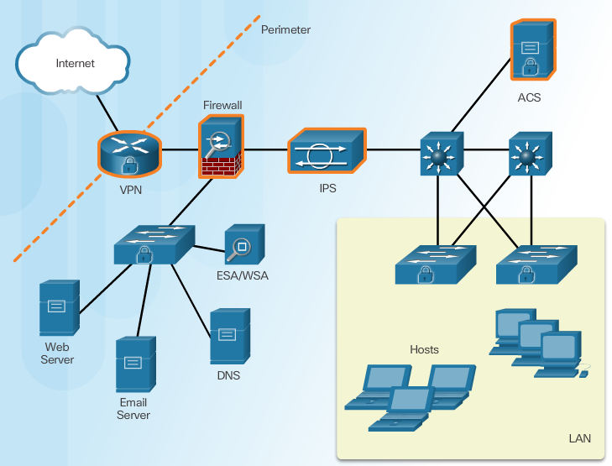
Securing LAN Elements
Various network security devices are required to protect the network perimeter from outside access.
As shown in the figure, these devices could include a hardened ISR that is providing VPN services, an ASA firewall appliance, an IPS appliance, and a AAA ACS server.
Securing an internal LAN is just as important as securing the outside network perimeter..
Notes:
6.1.1.1 Securing LAN Elements

Slide 6
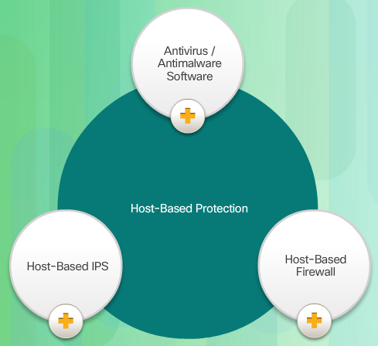
Traditional Endpoint Security
Historically, employee endpoints were company-issued computers which resided within a clearly defined LAN perimeter. These hosts were protected by firewalls and IPS scanning devices which worked well with hosts that were connected to the LAN and behind the firewall.
Notes:
6.1.1.2 Traditional Endpoint Security

Slide 7

The Borderless Network
The network has evolved to include traditional endpoints and new, lightweight, portable, consumerized endpoints such as iPhones, iPads, Android devices, tablets, and more.
These new endpoints have blurred the network border because access to network resources can be initiated by users from many locations using various connectivity methods.
Notes:
6.1.1.3 The Borderless Network

Slide 8
Securing Endpoints in the Borderless Network
Post malware attack questions:
Where did it come from?
What was the threat method and point of entry?
What systems were affected?
What did the threat do?
Can I stop the threat and root cause?
How do we recover from it?
How do we prevent it from happening again?
Host-Based Protection:
Antivirus/Antimalware
SPAM Filtering
URL Filtering
Blacklisting
Data Loss Prevention (DLP)
Larger organizations now require protection before, during, and after an attack. IT administrators must be able to answer the questions shown in Figure 1 (Left).
Organizations must also protect their endpoints from new threats and provide the protection outlined in Figure 2 (Right).
Notes:
6.1.1.4 Securing Endpoints in the Borderless Network

Slide 9
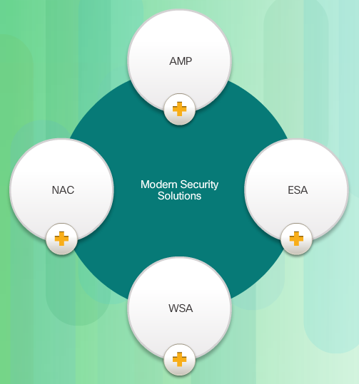
Modern Endpoint Security Solutions
Advanced Malware Protection provides endpoint protection from viruses and malware.
Email Security Appliances (ESA) provide filtering of SPAM emails before they reach the endpoint.
Web Security Appliances (WSA) provide filtering of websites and blacklisting before they reach the endpoint.
Network Admission Control (NAC) only permits authorized and compliant systems to connect to the network.
Notes:
6.1.1.5 Modern Endpoint Security Solutions

Slide 10

Hardware and Software Encryption of Local Data
Endpoints are also susceptible to data theft. For instance, if a corporate laptop is lost or stolen, a thief could scour the hard drive for sensitive information, contact information, personal information, and more.
The solution is to locally encrypt the disk drive with a strong encryption algorithm such as 256-bit AES encryption. The encryption protects the confidential data from unauthorized access. The encrypted disk volumes can only be mounted for normal read/write access with the authorized password.
Some operating systems such as MAC OSX natively provide encryption options. The Windows operating system supports encryption software such as BitLocker, TrueCrypt, Credant, VeraCrypt, and others.
Notes:
6.1.1.6 Hardware and Software Encryption of Local Data
6.1.1.7 Activity – Identify Endpoint Security Terminology (DND)

Slide 11
Topic 6.1.2: Antimalware Protection

Slide 12
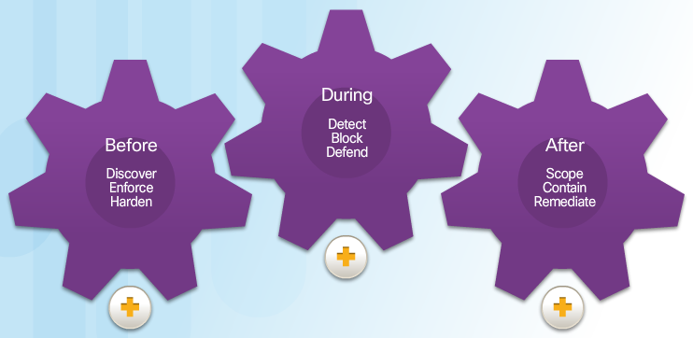
Advanced Malware Protection
Before: AMP helps to prevent known malware, policy-violating file types, and policy-violating communications from entering an extended network.
During: AMP continuously analyzes files and network traffic for threats that evade the first lines of defense.
After: AMP can quickly and efficiently understand, scope, contain, and remediate an active attack.
Notes:
6.1.2.1 Advanced Malware Protection

Slide 13
AMP and Managed Threat Defense
Talos teams gather real-time threat intelligence from a variety of sources:
1.6 million deployed security devices, including firewall, IPS, web, and email appliances
150 million endpoints
They then analyze this data:
100 TB of security intelligence daily
13 billion web requests per day
35% of the world’s enterprise email traffic
Notes:
6.1.2.2 AMP and Managed Threat Defense

Slide 14
AMP for Endpoints
AMP for Endpoints - AMP for Endpoints integrates with Cisco AMP for Networks to deliver comprehensive protection across extended networks and endpoints.
AMP for Networks - Provides a network-based solution and is integrated into dedicated Cisco ASA Firewall and Cisco FirePOWER network security appliances.
AMP for Content Security – This is an integrated feature in Cisco Cloud Web Security or Cisco Web and Email Security Appliances to protect against email and web-based advanced malware attacks.
Notes:
6.1.2.3 AMP for Endpoints

Slide 15
Topic 6.1.3: Email and Web Security

Slide 16

Securing Email and Web
Over the past 25 years, email has evolved from a tool used primarily by technical and research professionals to become the backbone of corporate communications. Each day, more than 100 billion corporate email messages are exchanged. As the level of use rises, security becomes a greater priority.
Mass spam campaigns are no longer the only concern. Today, spam and malware are just part of a complex picture that includes inbound threats and outbound risks. For this reason, Cisco acquired IronPort Systems in 2007. IronPort appliances are now part of the Cisco Email Security Appliance (ESA) and Cisco Web Security Appliance (WSA) product lines.
Notes:
6.1.3.1 Securing Email and Web

Slide 17
Cisco Email Security Appliance
Features and benefits of Cisco Email Security solutions:
Global threat intelligence
Spam blocking
Advanced malware protection
Outbound message control
Global threat intelligence - Cisco Talos provides a 24-hour view into global traffic activity. It analyzes anomalies, uncovers new threats, and monitors traffic trends.
Notes:
6.1.3.2 Cisco Email Security Appliance

Slide 18
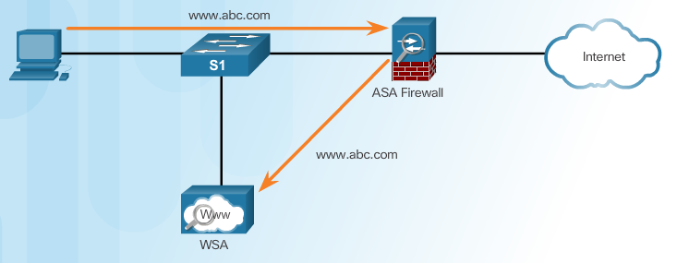
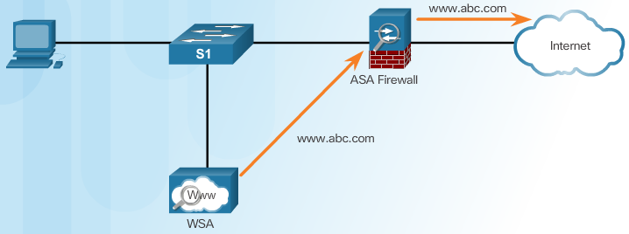
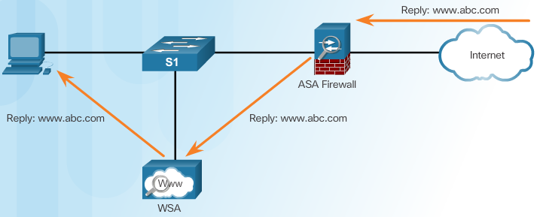
Cisco Web Security Appliance
Client Initiates Web Request
WSA Forwards Request
Reply Sent to WSA and Then To Client
Notes:
6.1.3.3 Cisco Web Security Appliance

Slide 19
Topic 6.1.4: Controlling Network Access

Slide 20
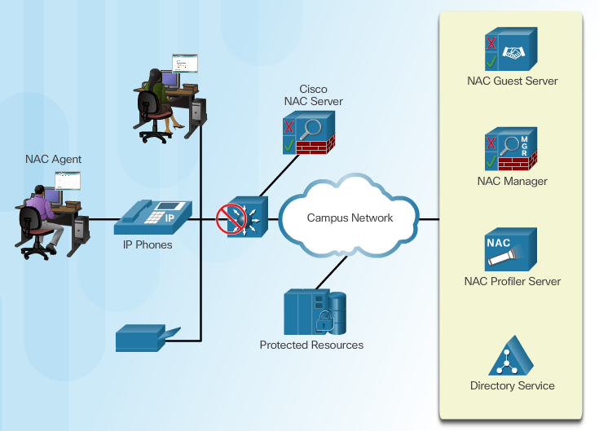
Cisco Network Admission Control
The purpose of Cisco Network Admission Control (NAC) is to allow only authorized and compliant systems, whether managed or unmanaged, to access the network.
Cisco NAC is also designed to enforce network security policy. NAC helps maintain network stability by providing authentication, authorization, and posture assessment (evaluating an incoming device against the policies of the network).
NAC also quarantines noncompliant systems and manages the remediation of noncompliant systems.
Notes:
6.1.4.1 Cisco Network Admission Control

Slide 21
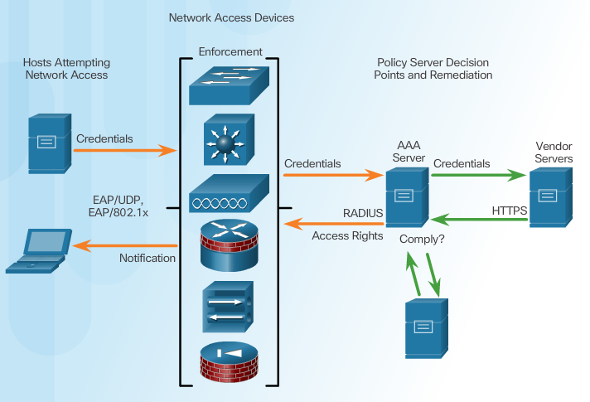
Cisco NAC Functions
Notes:
6.1.4.2 Cisco NAC Functions

Slide 22
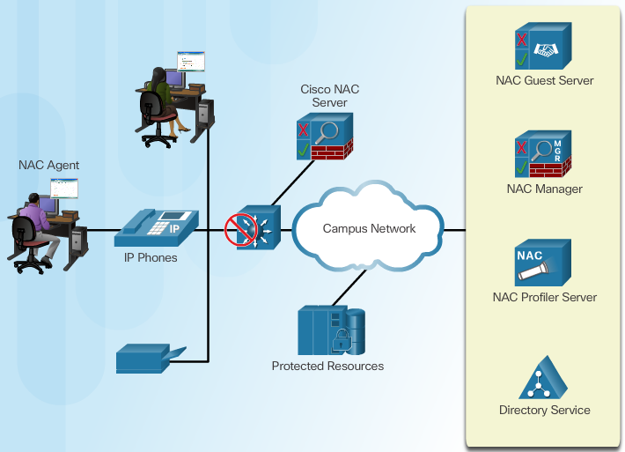
Cisco NAC Components
Notes:
6.1.4.3 Cisco NAC Components

Slide 23
Network Access for Guests
Three ways to grant sponsor permissions:
to only those accounts created by the sponsor
to all accounts
to no accounts (i.e., they cannot change any permissions)
Sponsors can be given role-based permissions to create accounts, edit accounts, suspend accounts, and run reports.
Notes:
6.1.4.4 Network Access for Guests

Slide 24
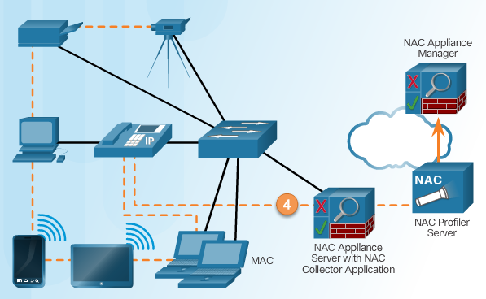
Cisco NAC Profiler
Cisco NAC Profiler enables the dynamic discovery, identification, and monitoring of all network-attached endpoints within an enterprise network. It manages these devices intelligently, based on user-defined security policies.
Notes:
6.1.4.5 Cisco NAC Profiler

Slide 25
Section 6.2: Layer 2 Security Considerations
Upon completion of the section, you should be able to:
Describe Layer 2 vulnerabilities.
Describe CAM table overflow attacks.
Configure port security to mitigate CAM table overflow attacks.
Configure VLAN Truck security to mitigate VLAN hopping attacks.
Implement DHCP Snooping to mitigate DHCP attacks.
Implement Dynamic Arp Inspection to mitigate ARP attacks.
Implement IP Source Guard to mitigate address spoofing attacks.

Slide 26
Topic 6.2.1: Layer 2 Security Threats

Slide 27
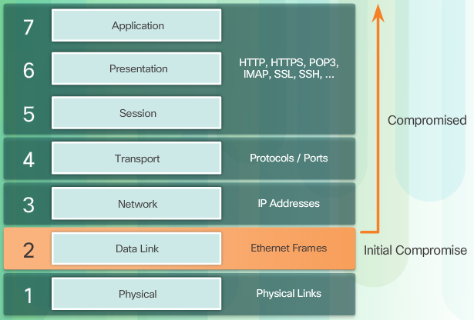
Describe Layer 2 Vulnerabilities
Network administrators routinely implement security solutions to protect the elements in Layer 3 up through Layer 7 using VPNs, firewalls, and IPS devices. However, as shown in Figure 2, if Layer 2 is compromised, then all layers above it are also affected. For example, if an employee or visitor with access to the internal network could capture Layer 2 frames, then all of the security implemented on the layers above would be useless.
Notes:
6.2.1.1 Describe Layer 2 Vulnerabilities

Slide 28
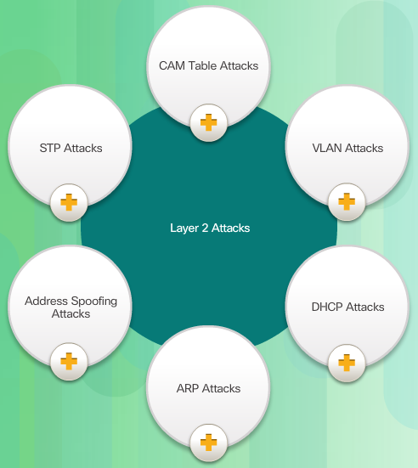
Switch Attack Categories
Security is only as strong as the weakest link in the system, and Layer 2 is considered to be that weakest link. This is because traditionally LANs were under the administrative control of a single organization. We inherently trusted all persons and devices connected to our LAN. Today, with BYOD and more sophisticated attacks, our LANs have become more vulnerable to penetration. Therefore, in addition to protecting Layer 3 to Layer 7, network security professionals must also mitigate attacks to the Layer 2 LAN infrastructure.
The first step in mitigating attacks on the Layer 2 infrastructure is to understand the underlying operation of Layer 2 and the threats posed by the Layer 2 infrastructure.
Notes:
6.2.1.2 Switch Attack Categories

Slide 29
Topic 6.2.2: CAM Table Attacks

Slide 30
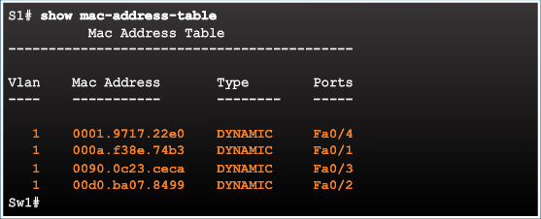
Basic Switch Operation
Notes:
6.2.2.1 Basic Switch Operation

Slide 31
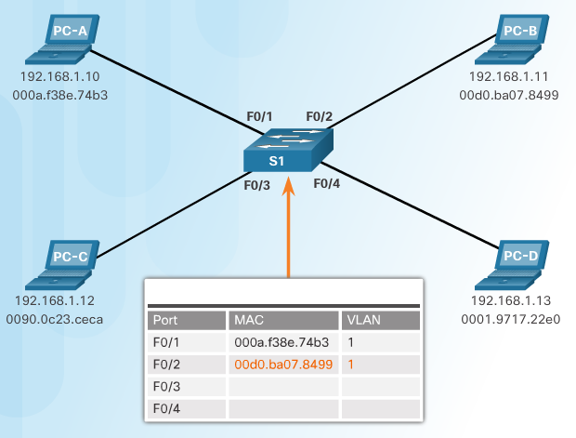
CAM Table Operation Example
Notes:
6.2.2.2 CAM Table Operation Example

Slide 32
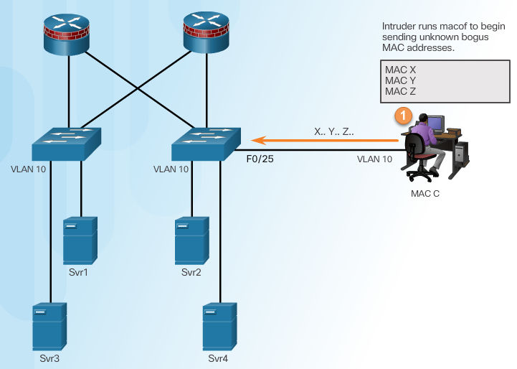
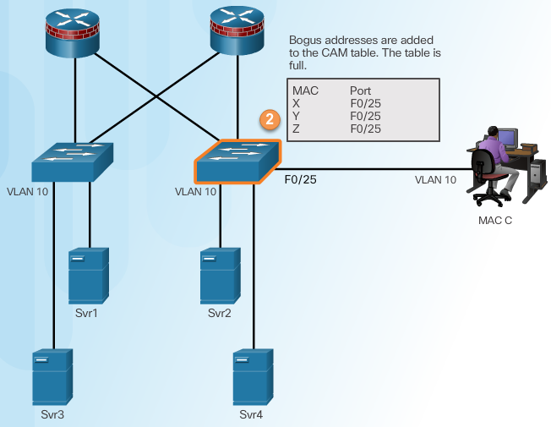
CAM Table Attack
Intruder Runs Attack Tool
Fill CAM Table
Notes:
6.2.2.3 CAM Table Attack

Slide 33
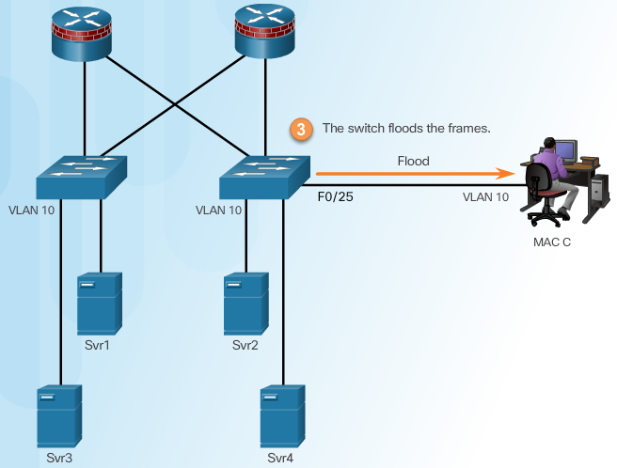
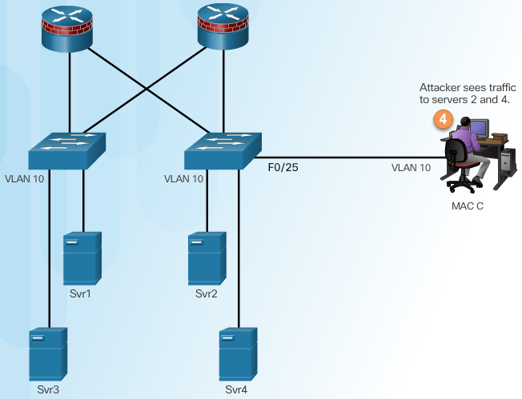
CAM Table Attack
Switch Floods All Traffic
Attacker Captures Traffic
Notes:
6.2.2.3 CAM Table Attack (Cont.)

Slide 34
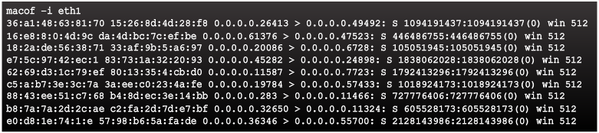
CAM Table Attack Tools
Notes:
6.2.2.4 CAM Attack Tools

Slide 35
Topic 6.2.3: Mitigating CAM Table Attacks

Slide 36
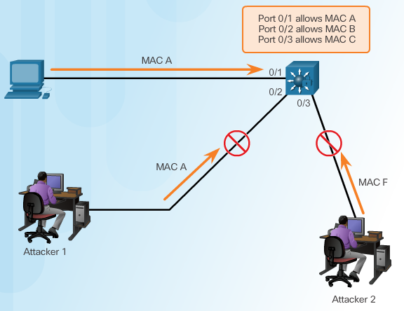
Countermeasure for CAM Table Attacks
Notes:
6.2.3.1 Countermeasure for CAM Table Attacks

Slide 37
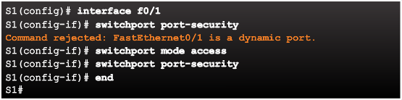
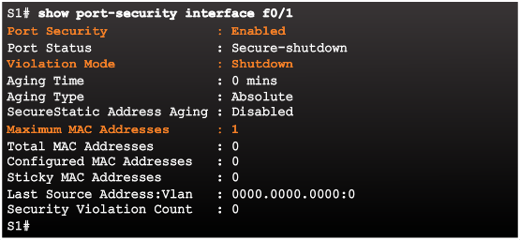
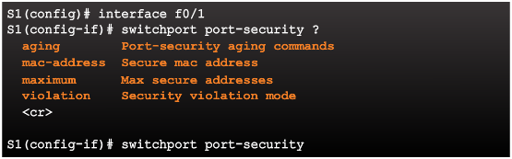
Port Security
Enabling Port Security
Verifying Port Security
Port Security Options
Notes:
6.2.3.2 Port Security

Slide 38
Enabling Port Security Options
Setting the Maximum Number of Mac Addresses
Manually Configuring Mac Addresses
Learning Connected Mac Addresses Dynamically
Notes:
6.2.3.3 Enabling Port Security Options

Slide 39
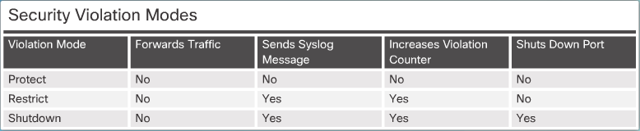
Port Security Violations
Security Violation Modes:
Protect
Restrict
Shutdown
Notes:
6.2.3.4 Port Security Violations

Slide 40
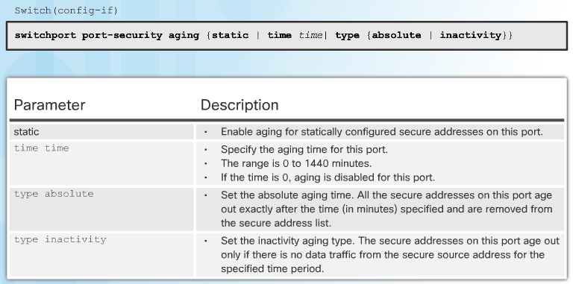
Port Security Aging
Port security aging can be used to set the aging time for static and dynamic secure addresses on a port. Two types of aging are supported per port:
Absolute - The secure addresses on the port are deleted after the specified aging time.
Inactivity - The secure addresses on the port are deleted only if they are inactive for the specified aging time.
Notes:
6.2.3.5 Port Security Aging

Slide 41

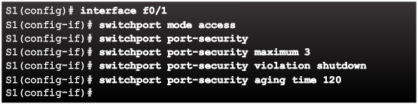
Port Security with IP Phones
An access port connecting an IP phone and a computer, as shown in Figure 1, typically requires two secure MAC addresses. However, on some switches this number should be set to three because when the port is connected to a Cisco IP phone, the IP phone requires up to two MAC addresses. The IP phone address is learned on the voice VLAN and might also be learned on the access VLAN. Connecting a PC to the IP phone requires an additional MAC address
Notes:
6.2.3.6 Port Security with IP Phones

Slide 42
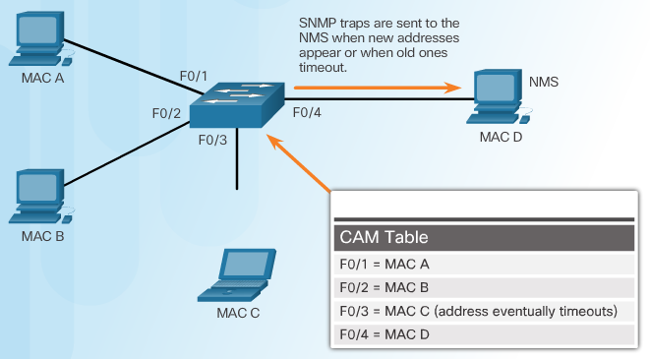
SNMP MAC Address Notification
Network managers need a way of monitoring who is using the network and what their location is. For example, if port F0/1 is secure on a switch, an SNMP trap is generated when a MAC address entry for that port disappears from the CAM table.
The MAC address notification feature sends SNMP traps to the network management station (NMS) whenever a new MAC address is added to, or an old address is deleted from the forwarding tables. MAC address notifications are generated only for dynamic and secure MAC addresses
Notes:
6.2.3.7 SNMP MAC Address Notification

Slide 43
Topic 6.2.4: Mitigating VLAN Attacks

Slide 44
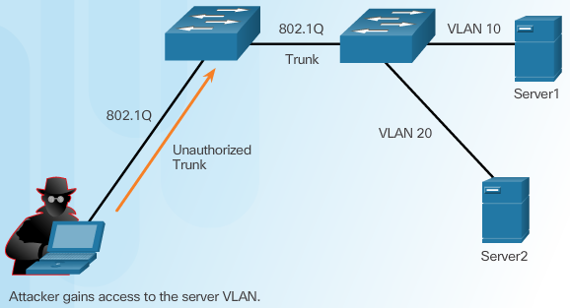
VLAN Hopping Attacks
Notes:
6.2.4.1 VLAN Hopping Attacks

Slide 45
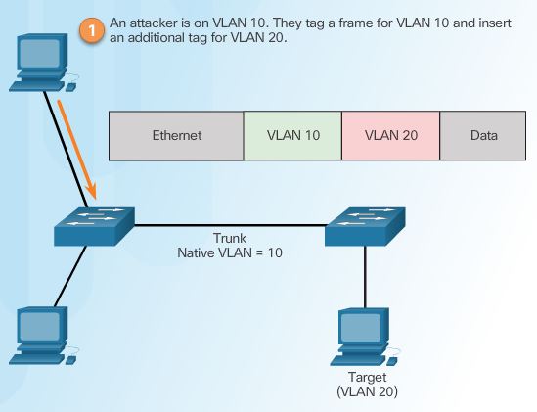
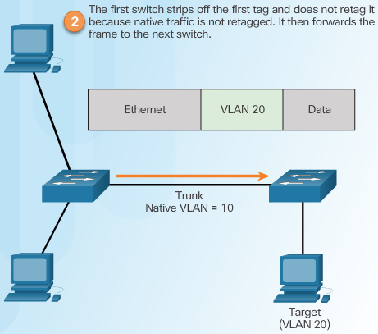
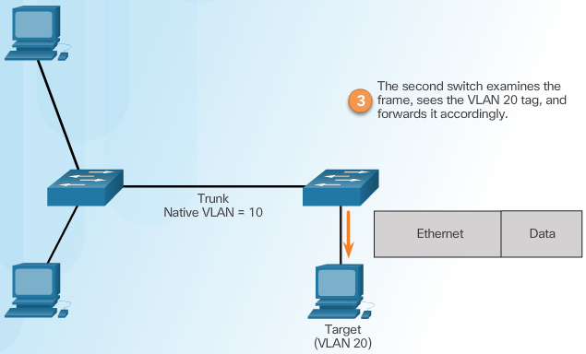
VLAN Double-Tagging Attack
Step 1 – Double Tagging Attack
Step 2 – Double Tagging Attack
Step 3 – Double Tagging Attack
Notes:
6.2.4.2 VLAN Double-Tagging Attack

Slide 46
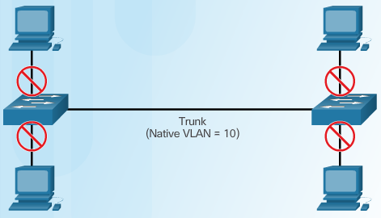
Mitigating VLAN Hopping Attacks
Disable trunking on all access ports.
Disable auto trunking and manually enable trunking.
Be sure that the native VLAN is used only for trunk lines.
Notes:
6.2.4.3

Slide 47
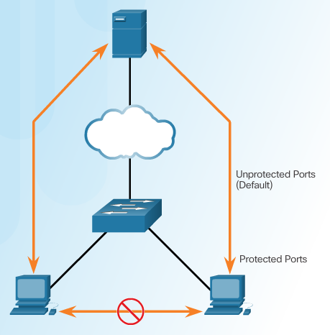
PVLAN Edge Feature
Some applications require that no traffic be forwarded at Layer 2 between ports on the same switch so that one neighbor does not see the traffic generated by another neighbor.
In such an environment, the use of the PVLAN (Private VLAN) Edge feature ensures that there is no exchange of unicast, broadcast, or multicast traffic between PVLAN edge ports on the switch, as shown in the figure. The PLVAN Edge feature is also called Protected Ports.
Notes:
6.2.4.4 PVLAN Edge Feature

Slide 48
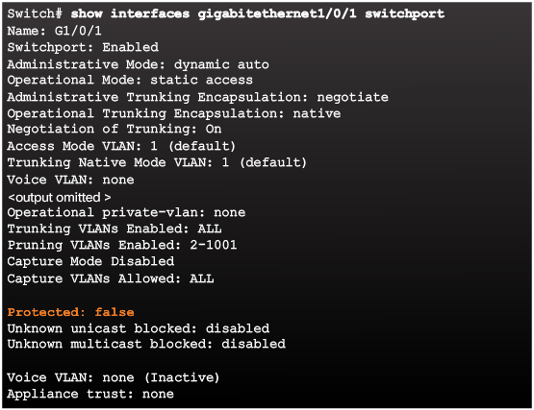
Verifying Protected Ports
To configure the PVLAN Edge feature, enter the switchport protected interface configuration mode command.
The PVLAN Edge feature can be configured on a physical interface or an EtherChannel group. When the PVLAN Edge feature is enabled for a port channel, it is enabled for all ports in the port-channel group. To disable protected port, use the no switchport protected interface configuration mode command
Notes:
6.2.4.5 Verifying Protected Ports

Slide 49
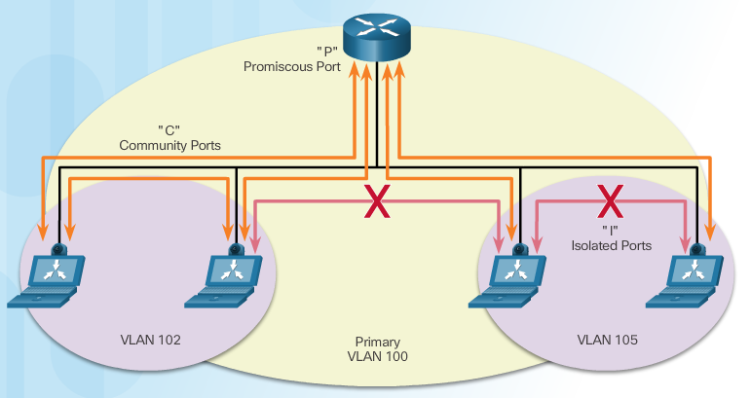
Private VLANs
PVLANs provide Layer 2 isolation between ports within the same broadcast domain. There are three types of PVLAN ports:
Notes:
6.2.4.6 Private VLANs
6.2.4.7 Video Demonstration – Private VLAN tutorial and demonstration

Slide 50
Topic 6.2.5: Mitigating DHCP Attacks

Slide 51
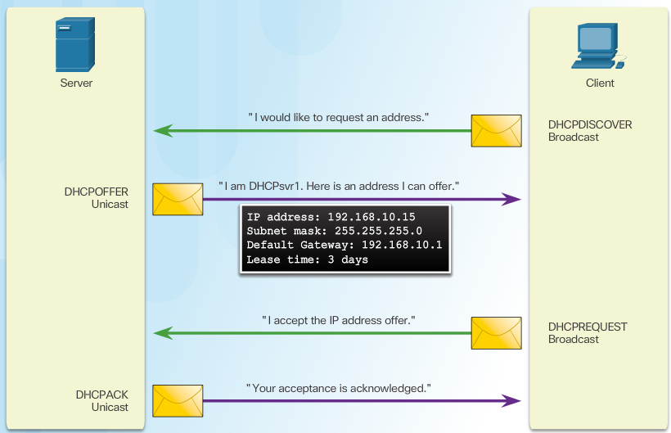
DHCP Spoofing Attack
Notes:
6.2.5.1 DHCP Spoofing Attack

Slide 52
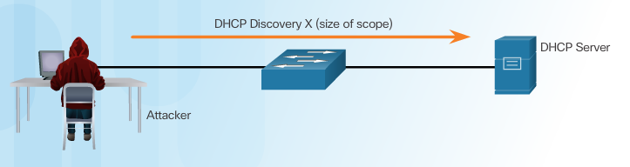
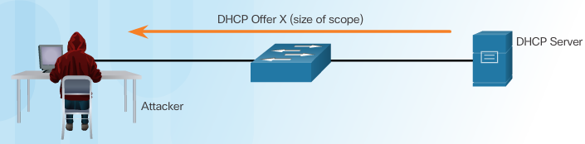
DHCP Starvation Attack
Attacker Initiates a Starvation Attack
A DHCP starvation attack is explained in the following figures:
In Figure 1, an attacker launches the Gobbler tool. Gobbler identifies the size of the DHCP scope and sends a DHCP discovery message for every leasable IP address in the scope.
In Figure 2, the DHCP provides offers for every received discovery message.
DHCP Server Offers Parameters
Notes:
6.2.5.2 DHCP Starvation Attack

Slide 53
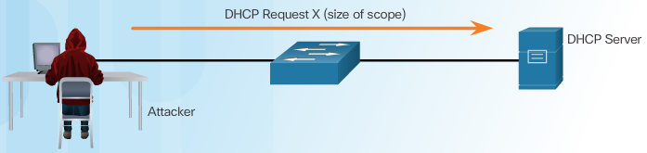
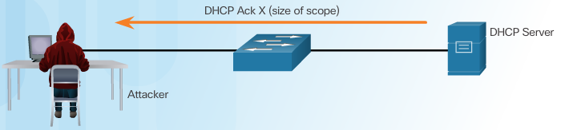
DHCP Starvation Attack
Client Requests all Offers
In Figure 3, Gobbler requests all the DHCP offers.
In Figure 4, the server acknowledges every request.
DHCP Server Acknowledges All Requests
Gobbler has the ability to look at the entire scope of leasable IP addresses and tries to lease them all. Specifically, it creates DHCP discovery messages with bogus MAC addresses.
Notes:
6.2.5.2 DHCP Starvation Attack (Cont.)

Slide 54
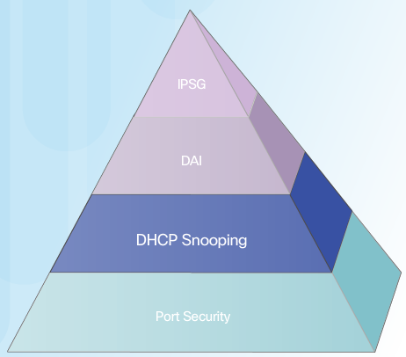
Mitigating VLAN Attacks
The switch will deny packets containing specific information:
Unauthorized DHCP server messages from an untrusted port
Unauthorized DHCP client messages not adhering to the snooping binding table or rate limits
DHCP relay-agent packets that include option-82 information on an untrusted port
DHCP option 82 provides additional security when DHCP is used to allocate network addresses. It enables the controller to act as a DHCP relay agent to prevent DHCP client requests from untrusted sources. You can configure the controller to add option 82 information to DHCP requests from clients before forwarding the requests to the DHCP server.
Notes:
1.2.3.3 Trojan Horses
1.2.3.4 Trojan Horse Classification

Slide 55
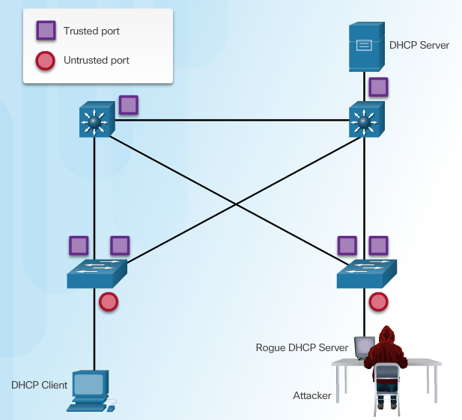
Configuring DHCP Snooping
Notes:
6.2.5.4 Configuring DHCP Snooping
6.2.5.5 Configuring DHCP Snooping Example

Slide 56
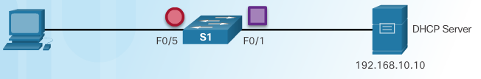
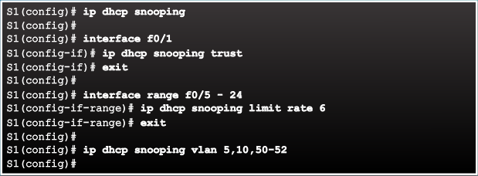
Configuring DHCP Snooping Example
DHCP Snooping Reference Topology
Configuring a Maximum Number of MAC Addresses
Notes:
6.2.5.5 Configuring DHCP Snooping Example

Slide 57
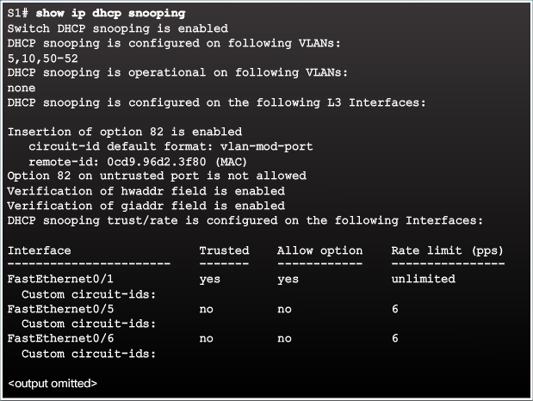
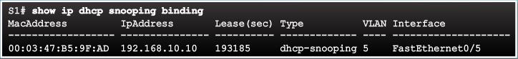
Configuring DHCP Snooping Example
Verifying DHCP Snooping
Configuring a Maximum Number of MAC Addresses
Notes:
6.2.5.5 Configuring DHCP Snooping Example (Cont.)

Slide 58
Topic 6.2.6: Mitigating ARP Attacks

Slide 59
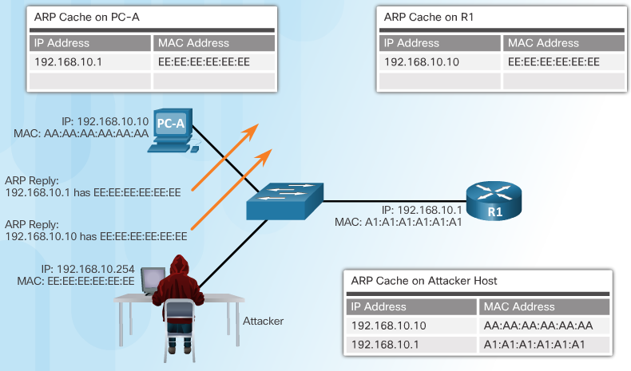
ARP Spoofing and ARP Poisoning Attack
Notes:
6.2.6.1 ARP Spoofing and ARP Poisoning Attack

Slide 60
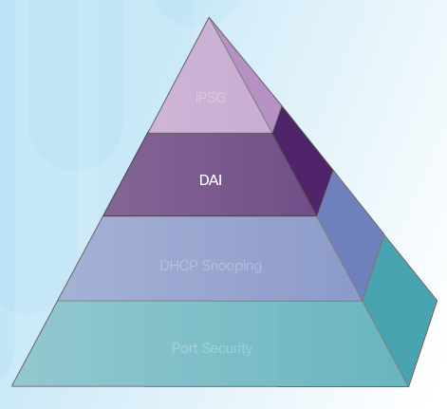
Mitigating ARP Attacks
Dynamic ARP Inspection:
Notes:
6.2.6.2 Mitigating ARP Attacks

Slide 61
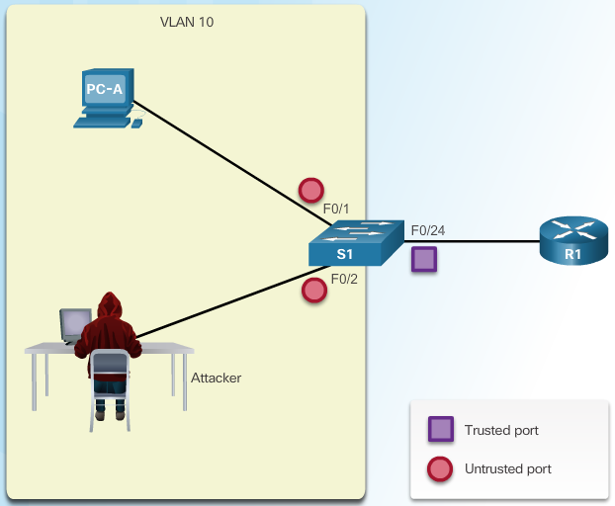
Configuring Dynamic ARP Inspection
Notes:
6.2.6.4 Configuring Dynamic ARP Inspection
6.2.6.5 Configuring Dynamic ARP Inspection Example

Slide 62


Configuring DHCP Snooping Example
ARP Reference Topology
Configuring Dynamic ARP Inspection
Notes:
6.2.6.4 Configuring Dynamic ARP Inspection Example

Slide 63

Configuring DHCP Snooping Example
DAI can also be configured to check for both destination or source MAC and IP addresses:
Destination MAC - Checks the destination MAC address in the Ethernet header against the target MAC address in ARP body
Source MAC - Checks the source MAC address in the Ethernet header against the sender MAC address in the ARP body.
IP address - Checks the ARP body for invalid and unexpected IP addresses including addresses 0.0.0.0, 255.255.255.255, and all IP multicast addresses.
Checking Source, Destination, and IP
Notes:
6.2.6.4 Configuring Dynamic ARP Inspection Example (Cont.)

Slide 64
Topic 6.2.7: Mitigating Address Spoofing Attacks

Slide 65


Address Spoofing Attack
Notes:
6.2.7.1 Address Spoofing Attack

Slide 66

Mitigating Address Spoofing Attacks
For each untrusted port, there are two possible levels of IP traffic security filtering:
Source IP address filter
Source IP and MAC address filter
To protect against MAC and IP address spoofing, configure the IP Source Guard (IPSG) security feature. IPSG operates just like DAI, but it looks at every packet, not just the ARP packets. Like DAI, IPSG also requires that DHCP snooping be enabled.
Notes:
6.2.7.2 Mitigating Address Spoofing Attacks

Slide 67



Configuring IP Source Guard
IP Source Guard Reference Topology
Configuring IP Source Guard
Checking IP Source Guard
Notes:
6.2.7.3 Configuring IP Source Guard

Slide 68
Topic 6.2.8: Spanning Tree Protocol

Slide 69

Introduction to the Spanning Tree Protocol
Check the animation – PC1 sends broadcast frames.
Notes:
6.2.8.1 Introduction to the Spanning Tree Protocol

Slide 70

Various Implementations of STP
STP Compensates for Network Failure.
In this scenario, Trunk 1 fails. Trunk 2 will be unblocked.
Notes:
6.2.8.2 Various Implementations of STP

Slide 71

STP Port Roles
Alternate or backup ports are configured to be in a blocking state to prevent loops. Alternate ports are selected only on trunk links where neither end is a root port.
Notes:
6.2.8.3 STP Port Roles

Slide 72

STP Root Bridge
As shown in Figure 1, every spanning tree instance has a switch designated as the root bridge. The root bridge serves as a reference point for all spanning tree calculations to determine which redundant paths to block.
Notes:
6.2.8.4 STP Root Bridge

Slide 73

STP Path Cost
Notes:
6.2.8.5 STP Path Cost

Slide 74

802.1D BPDU Frame Format
Notes:
6.2.8.6 802.1D BPDU Frame Format

Slide 75

BPDU Propagation and Process
Notes:
6.2.8.7 BPDU Propagation and Process

Slide 76

Extended System ID
Notes:
6.2.8.8 Extended System ID

Slide 77

Select the Root Bridge
Notes:
6.2.8.9 Select the Root Bridge
6.2.8.10 Activity – Identify the 802.1D RSTP Port Roles
6.2.8.11 Activity – Troubleshoot STP Configuration Issues
6.2.8.12 Video Demonstration – Observing Spanning Tree Protocol Operation

Slide 78
Topic 6.2.9: Mitigating STP Attacks

Slide 79


STP Manipulation Attacks
Spoofing the Root Bridge
Successful STP Manipulation Attack
Notes:
6.2.9.1 STP Manipulation Attacks

Slide 80

Mitigating STP Attacks
Notes:
6.2.9.2 Mitigating STP Attacks

Slide 81

Configuring PortFast
Notes:
6.2.9.3 Configuring PortFast

Slide 82

Configuring BDPU Guard
Notes:
6.2.9.4 Configuring BPDU Guard

Slide 83

Configuring Root Guard
Notes:
6.2.9.5

Slide 84

Configuring Loop Guard
Traffic on bidirectional links flows in both directions. If for some reason one direction traffic flow fails, this creates a unidirectional link which can result in a Layer 2 loop. STP relies on continuous reception or transmission of BPDUs based on the port role. The designated port transmits BPDUs, and the non-designated port receives BPDUs. A Layer 2 loop is usually created when an STP port in a redundant topology stops receiving BPDUs and erroneously transitions to the forwarding state
Notes:
6.2.9.5 Configuring Loop Guard

Slide 85
Section 6.3: Summary
Chapter Objectives:
Explain endpoint security.
Describe various types of endpoint security applications.
Describe Layer 2 vulnerabilities.
Notes:
6.3.1.1 Packet Tracer – Layer 2 Security
6.3.1.2 Packet Tracer – Layer 2 VLAN Security
6.3.1.3 Lab – Securing Layer 2 Switches
6.3.1.4 Summary

Slide 87


Instructor Resources
Remember, there are helpful tutorials and user guides available via your NetSpace home page. (https://www.netacad.com)
These resources cover a variety of topics including navigation, assessments, and assignments.
A screenshot has been provided here highlighting the tutorials related to activating exams, managing assessments, and creating quizzes.
1
2
Notes:
https://www.netacad.com

